Slide 1
Schizophrenia Assignment

Slide 2


Schizophrenia Assignment Abnormal Psychology GNED 2035 Professor: Meredith Lowe April 6, 2018

Slide 3


Schizophrenia
Important points:
1. Schizophrenia is a chronic mental disorder that affects how a person thinks, feels, and behaves. People with schizophrenia strips a persons mind, of normal thoughts, and replaces them with distortion, and delusion and illogical thinking.
2. It is observed that that the children with parents having this disorder and the identical twins are affected the most and general population the least.
3. Rate of mental illness continue to rise for old aged people between 70 to 89 by 2041.
4. Hallucinations and Delusions are one of the first symptoms of Schizophrenia.
5. Genetic Factors-compelling genetic proof that reveals biological relations with this disorder.
Three phases of Schizophrenia:
Prodromal phase, Acute phase, residual phase.
7. This mental disorder ranks 5th worldwide in which 50% attempt suicide and 10% die from it.

Slide 4
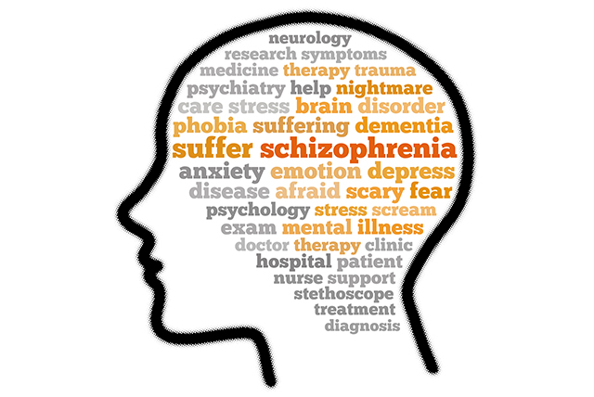
Important points continued
8. Diathesis-Stress Model of Schizophrenia to understand the role of stress in serious mental illness.
9. Difference between delusion and hallucination.
10. Schizophrenia name was given by psychiatrist Eugen Bleuler in 1911.
11. Treatment approaches of Schizophrenia through Antipsychotic Drugs and personal therapy.
12. There are many sub-types of Schizophrenia like disorganized type-appear crazy, hallucinations, inappropriate affect, delusions involving sexual and religious themes.
13. Rates of Schizophrenia is about six times greater than diabetes in US.
14. Drugs can help to reduce the mental disorder but can’t cure completely.
15. There is controversial research that measles virus can cause schizophrenia.
16. Schizophrenia is found usually at the age around 18 to 21 which is now general.
17. This mental disorder also affects job, relationships, intimacy, ability to succeed, show a lack of appropriate responses to people and events.

Slide 5
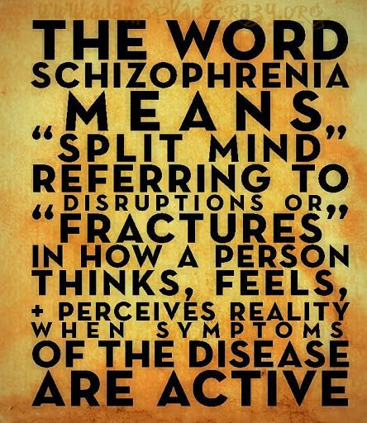
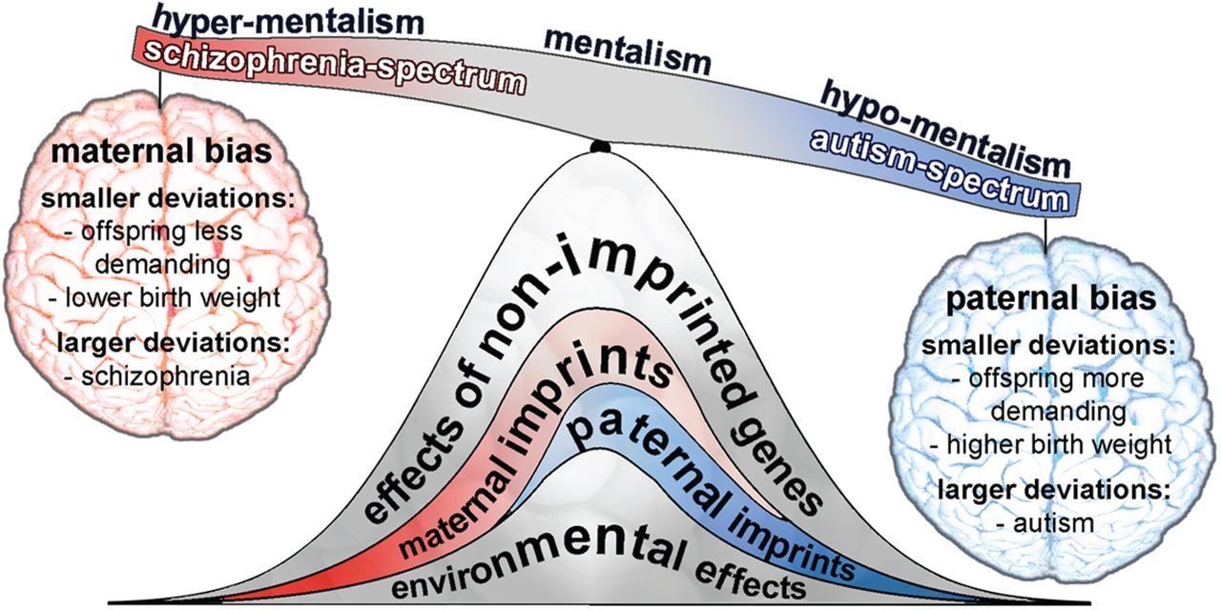
Important points continued
18. Emil Kraepelin is one of the fathers of modern psychiatry. Earlier, Schizophrenia was named disorder according to him.
19. During acute phase, a person may not think clearly and give inadequate responses to others and other daily tasks also known as delusions and hallucinations.
20. Auditory Hallucinations is the most common hallucinations involving talking voices like Randy Orton (LOL ☺).

Slide 6
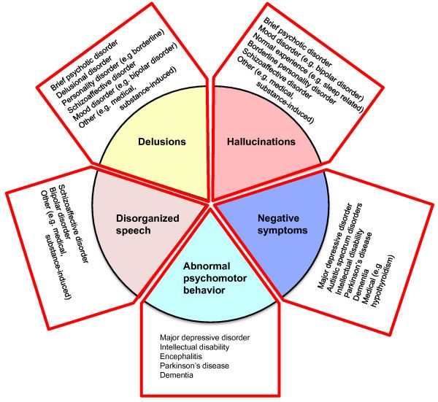
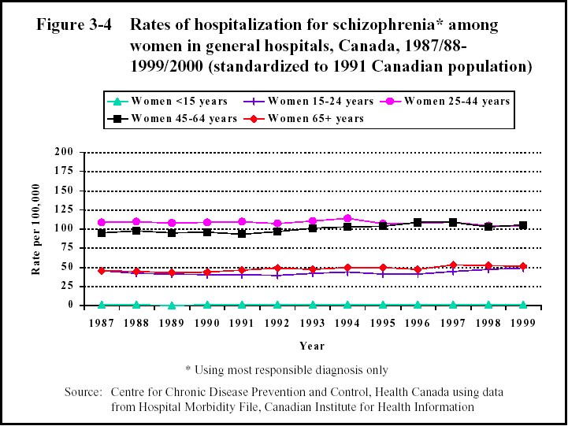
Charts/Diagrams related to Schizophrenia

Slide 7
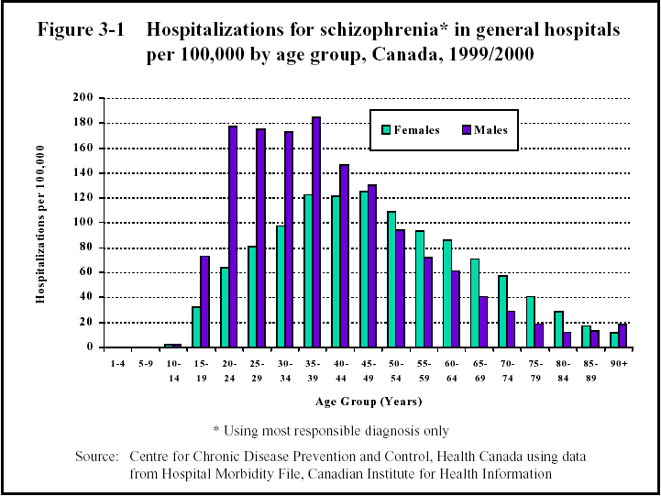
Charts/Diagrams related to Schizophrenia

Slide 8

More facts on Schizophrenia
1. Women between the ages of 25 – 30 will experience schizophrenia for the first time.
2. About 25% of people with schizophrenia show physical changes in their brains that can be observed with the help of CT scans.
3. Schizophrenic people are lazy. No. Schizophrenic people just need some additional support with their daily tasks.
4. It affects 1 in 100 people worldwide that makes about 300,000 Canadians, including over 40,000 of our BC neighbors.
5. 94% of patients with schizophrenia have cognitive deficits. Cognitive problems include reduced attention span, difficulties with memory, reasoning, judgement, problem solving, and decision making.

Slide 9

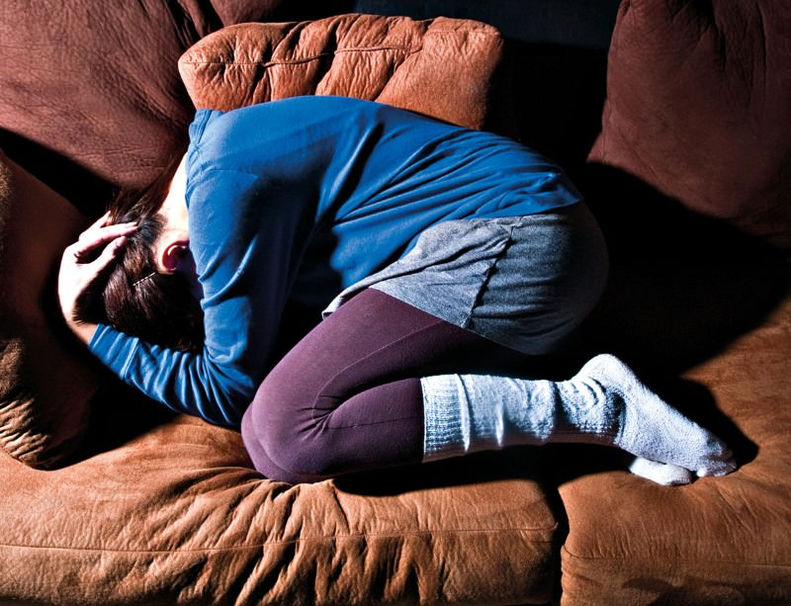
Short Reflection
Schizophrenia is a serious mental disorder. Men and women face it equally but men start experiencing it early 20 but for women, they face it some years after. It isn’t known exactly what causes schizophrenia, but it’s likely a combination of several factors. Studies show that families who receive education about the illness are more supportive, less judgmental, and less critical. Factors related to genetic and environment also play a significant role in the development of schizophrenia. It is very controversial and very hard to determine and diagnose Schizophrenia but we can reduce it to some certain extent. Even some people are unaware and do not realize of their illness and they refuse to seek help. There is also a misconception that drugs can help in curing this mental disorder. No, it can only reduce the symptoms to some extent or it is partly effective. Many patients with schizophrenia have a sedentary lifestyle that may also contribute to the deficits in brain tissue volumes observed.

